Slide 1


Slide 2
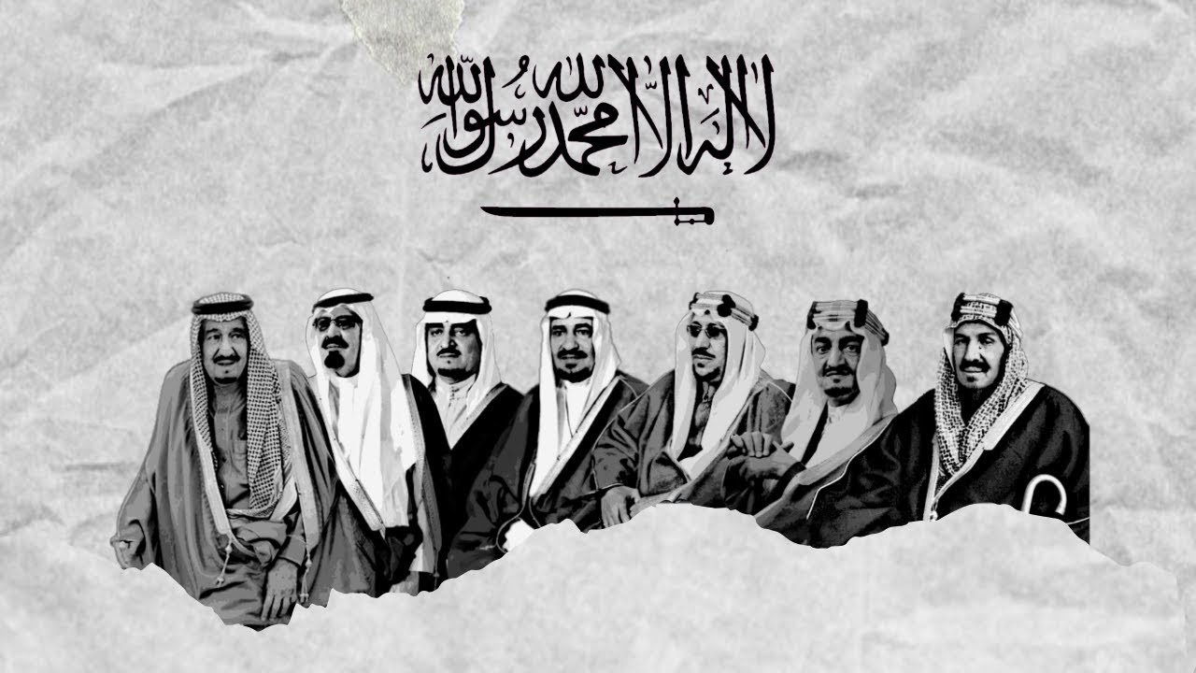

Slide 3
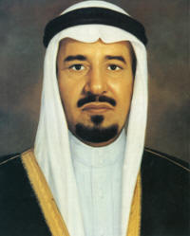
GRADE 11 / S.Y. 2020-2021
LESSON #1_ (4th Quarter)
King Khalid Bin Abdulaziz Al Saud
ARABIC TEACHER: EMAN ALROWAIHI

Slide 4


Slide 5


Slide 6
King Khalid was the fourth King of Saudi Arabia. He ruled Saudi Arabia from 1975AD to 1982 AD. King Khalid succeeded to the throne on the death of King Faisal, King Khalid who, like his father was most at home in the desert, assumed his new and heavy responsibilities with dignity.

Slide 7
He already had considerable experience of government, having served as an Adviser to his brother prince Faisal when he was a governor of the Hijaz. King Khalid achieved much in both domestic and foreign policy

Slide 8
Not long after his accession, he launched the second Five Year Plan which set in train much of the infrastructural development on which the future health and prosperity of the Kingdom was to depend.

Slide 9
He involved himself in the intractable Lebanese civil war; he convened the historic summit of Arab nations in Taif and the Holy City of Makkah in 1981 AD. He inaugurated the Gulf Cooperation Council in the same year.

Slide 10


Slide 11
English | Arabic | Pronunciation
King Khalid | الملك خالد | Almalik Khalid
Fourth King | الملك الرابع | Almalik alraabie
Ruled | حكم | Hukum
Succeeded to the throne | نجح إلى العرش | Najaha illa al-arsh
Responsibilities | مسئوليات | Masuwliaat
Government | حكومة | Hukuma

Slide 12
Adviser | مرشد | Murshid
Governor of the Hijaz | حاكم الحجاز | Hakim alhijaz
Five years | خمسة سنوات | Khamsa sanawat
Health and prosperity | صحة وازدهار | Siha wa aizdihaar
Civil war | حرب أهلية | Harb ‘ahlia

Slide 13


